Slide 1
Listify
Bruno Prela, Max Lancaster, Phil Ou, Spencer Kim

Slide 2
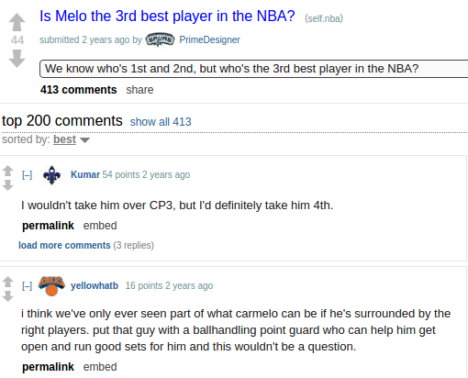
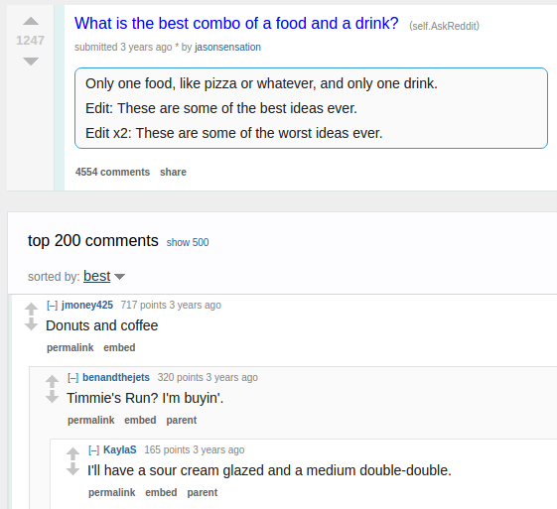

Slide 3

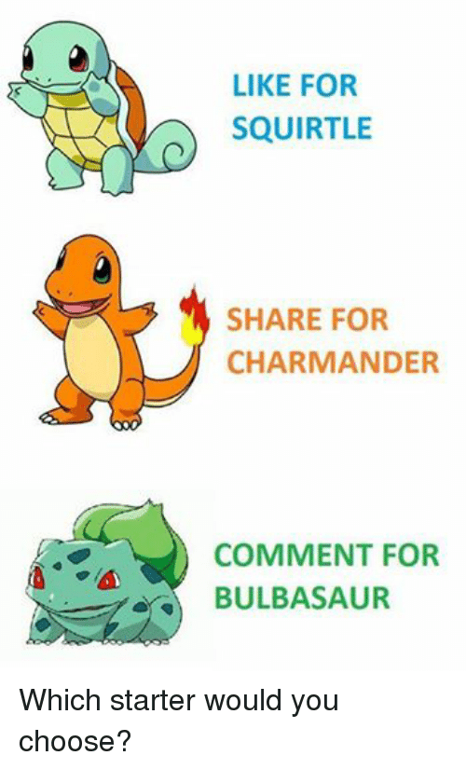

Slide 4
Purpose and Motivation
- Often difficult to come to a consensus on an ordering of items
- People love to show off their opinions on the ordering of different topics
- Our app would allow users to create lists for people to fill out by designating the items that can be put on the list (text, hyperlinks and images), while also allowing freedom for suggestions.
- This is a quick tool to allow people to come to a consensus not just on what is important, but also the order in which it is important.
- There are public and private rankings where private rankings can only be edited by people the invites get sent to. With public rankings we can also populate a global feed showing the rankings that are the most active. Also with user profiles we can allow authenticated users to view and edit public rankings of other users.

Slide 5
Key Concept

Slide 6
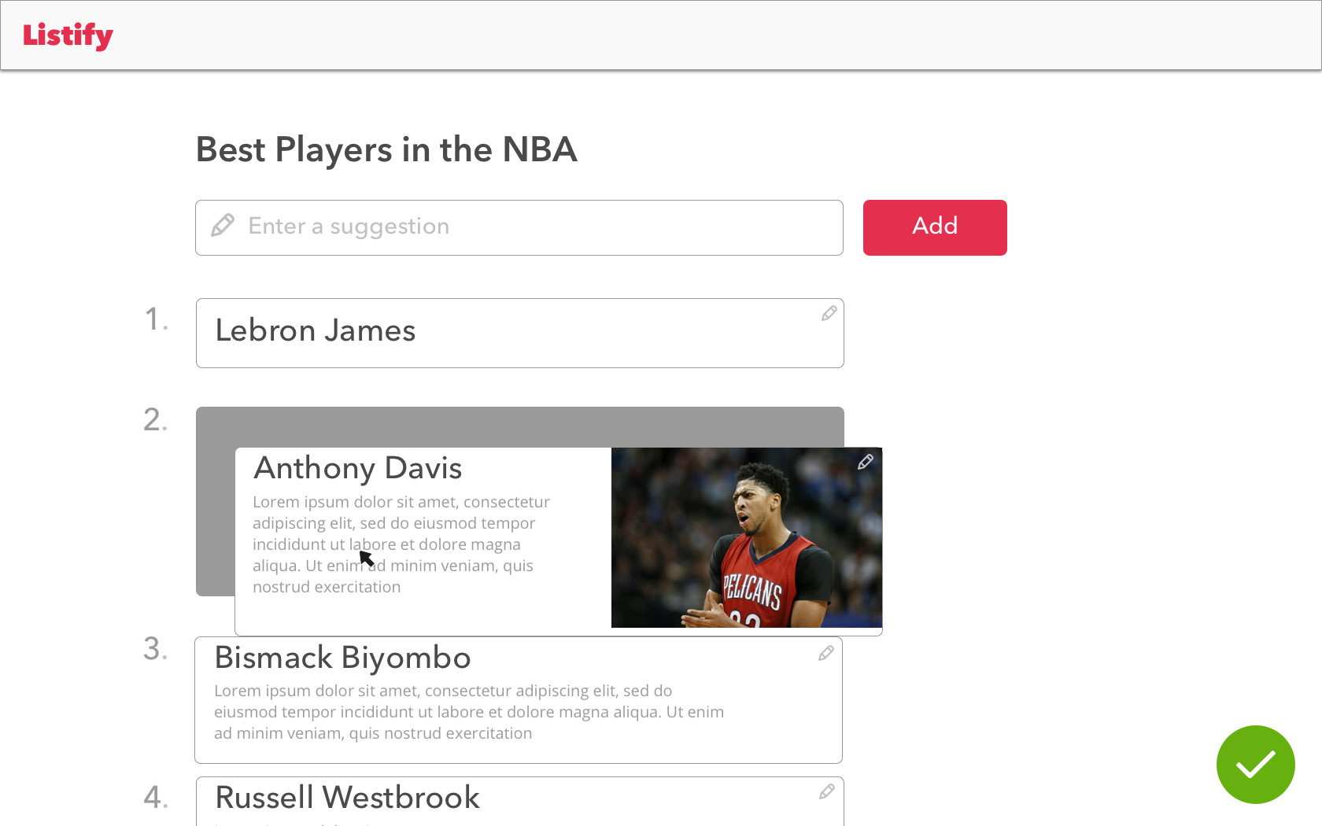
Ranking
Purpose: Allow individuals to express their own preferences
Operational Principal: Aggregates individual responses into one cohesive ranking

Slide 7
Other Features

Slide 8
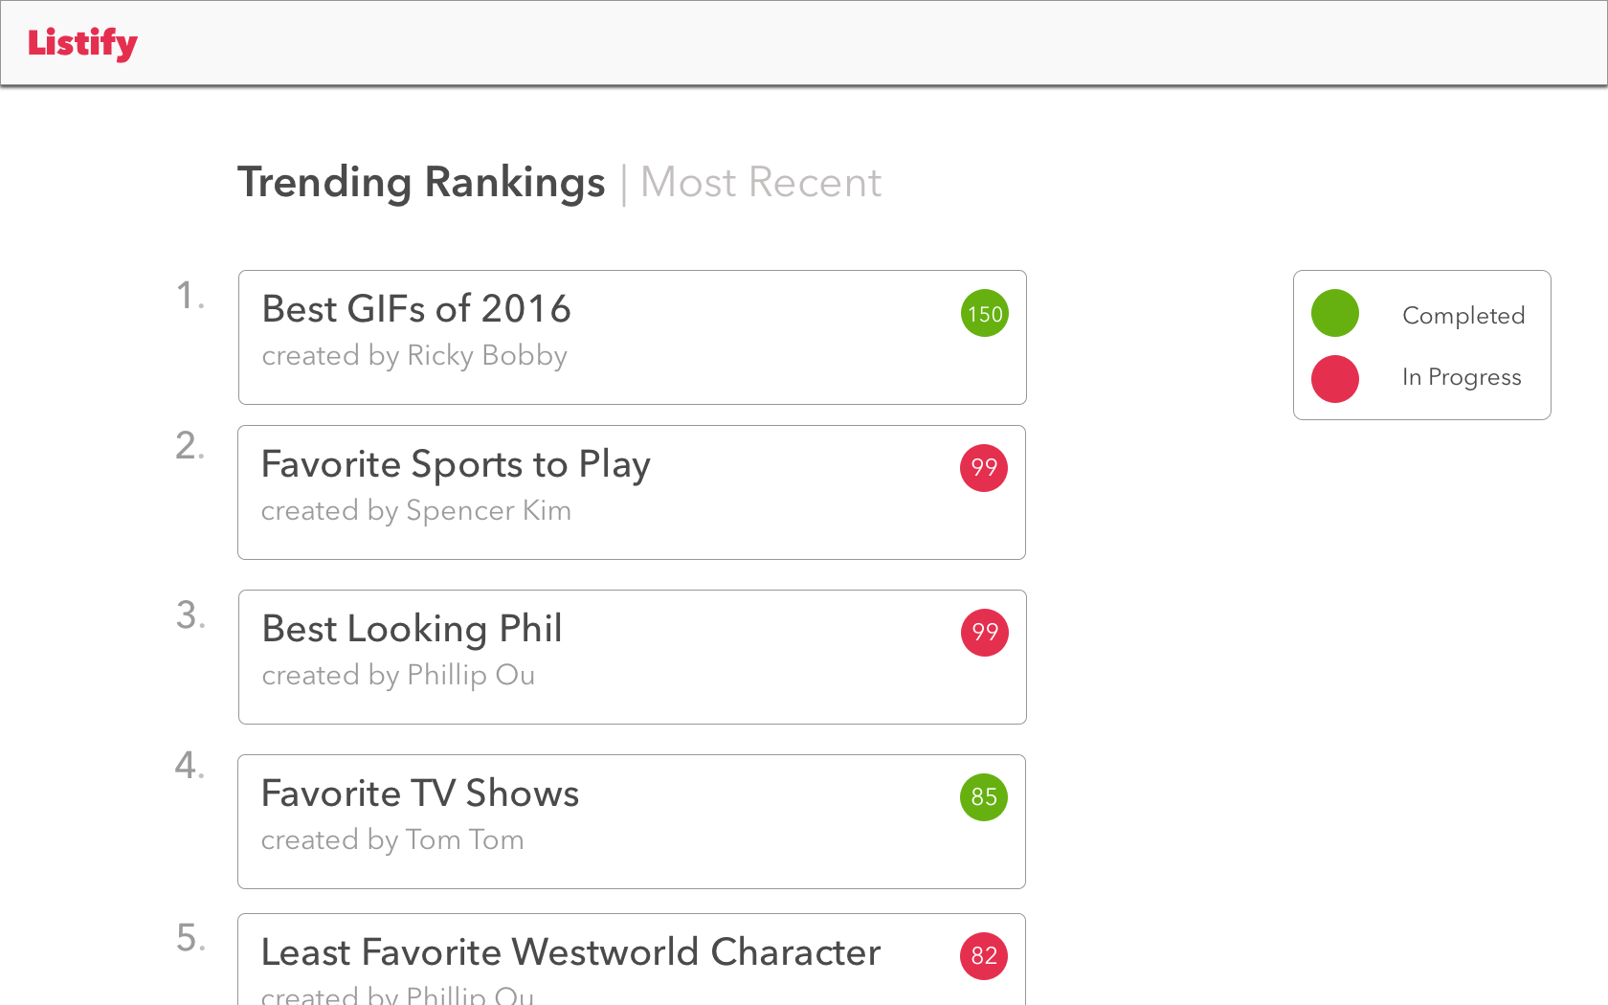
Social
Social component allows users to poll everyone using the application

Slide 9
Risks and Error Handling
Users may create multiple accounts to upvote their own rankings or downvote others’ rankings
Users may put invalid/inappropriate items into a list
Multiple users may create the same list of items
Best to Worst vs. Worst to Best lists

